Slide 1

Binary Search
Note: Please turn off your microphone and camera.
Mr. Gao's Algorithm
Competition Training Camp

Slide 2

Binary search
Quickly find a number in a sorted array.
Algorithm principle: Since the array is already sorted, at least half of the elements can be eliminated each time.
Complexity:
$O(logn)$

Slide 3
Binary search
Example: Find 45
10 23 28 34 36 37 45 50 52 59 70
l mid r
l mid r
l/mid r

Slide 4
Binary search
Code:
int a[1010], x, l = 0, r = n-1, mid; //Array a sorted in ascending order
while (l <= r){
mid = (l + r) / 2;
if (a[mid] == x) {print(); break;} //x found
if (a[mid] < x) l = mid+1;
else r = mid-1;
}
if (l > r) not found

Slide 5
Various forms of binary search
Find the first number greater than x
Find the first number greater than or equal to x
Find the last number less than x
Find the last number less than or equal to x
...

Slide 6
Binary search code template
int a[1010], x, l = 0, r = n-1, mid; //Array a sorted in ascending order
while (l <= r){
mid = (l + r) / 2;
if ( ) l = mid + 1;
else r = mid - 1;
}
return ( );

Slide 7
first number greater than x
int a[1010], x, l = 0, r = n-1, mid; //Array a[] sorted in ascending order
while (l <= r){
mid = (l + r) / 2;
if ( ) l = mid + 1;
else r = mid - 1;
}
return ( );

Slide 8
first number greater than or equal to x
int a[1010], x, l = 0, r = n-1, mid; //Array a sorted in ascending order
while (l <= r){
mid = (l + r) / 2;
if ( ) l = mid + 1;
else r = mid - 1;
}
return ( );

Slide 9
last number less than x
int a[1010], x, l = 0, r = n-1, mid; //Array a sorted in ascending order
while (l <= r){
mid = (l + r) / 2;
if ( ) l = mid + 1;
else r = mid - 1;
}
return ( );

Slide 10
last number less than or equal to x
int a[1010], x, l = 0, r = n-1, mid; //Array a sorted in ascending order
while (l <= r){
mid = (l + r) / 2;
if ( ) l = mid + 1;
else r = mid - 1;
}
return ( );

Slide 11
Summary of binary search code
Fixed part remains unchanged
Choose appropriate logical condition for the if-statement
Choose the correct answer (generally ' l' or 'r' ) .
Learn to generate your own data for verification

Slide 12
Example problem: Find the number - 1
while (l <= r){
mid = (l + r) / 2;
if ( ) l = mid + 1;
else r = mid - 1;
}
return ( );
First number greater than x
First number greater than or equal to x
Last number less than x
Last number less than or equal to x
First number less than x
Last number greater than x
Notes:
XMOJ 1241

Slide 13
Example problem: Find the number - 2
while (l <= r){
mid = (l + r) / 2;
if ( ) l = mid + 1;
else r = mid - 1;
}
return ( );
First number less than x
First number less than or equal to x
Last number greater than x
Last number greater than or equal to x
First number greater than x
Last number less than x
Notes:
XMOJ 1241

Slide 14
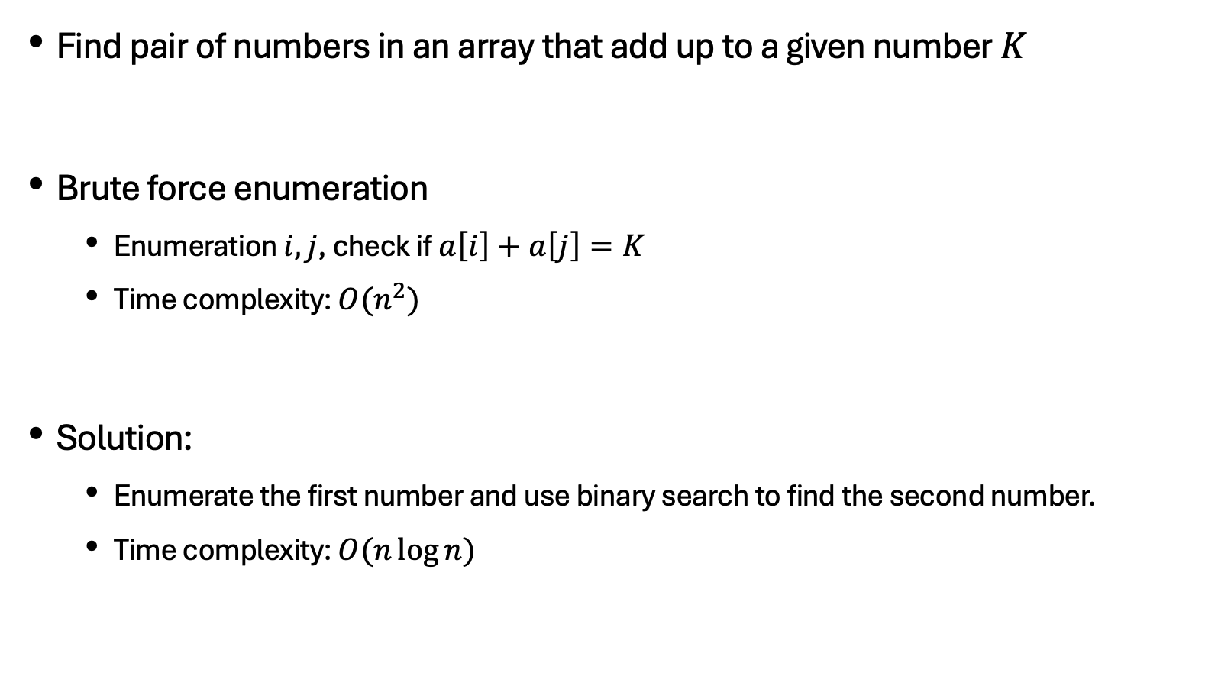
Example problem: number pair with Given sum
Find pair of numbers in an array that add up to a given number $K$
Brute force enumeration
Enumeration $i,j$, check if $a\left[i\right]+a\left[j\right]=K$
Time complexity: $O(n^{2})$
Solution:
Enumerate the first number and use binary search to find the second number.
Time complexity: $O(n\log{n})$
Notes:
XMOJ 1239

Slide 15
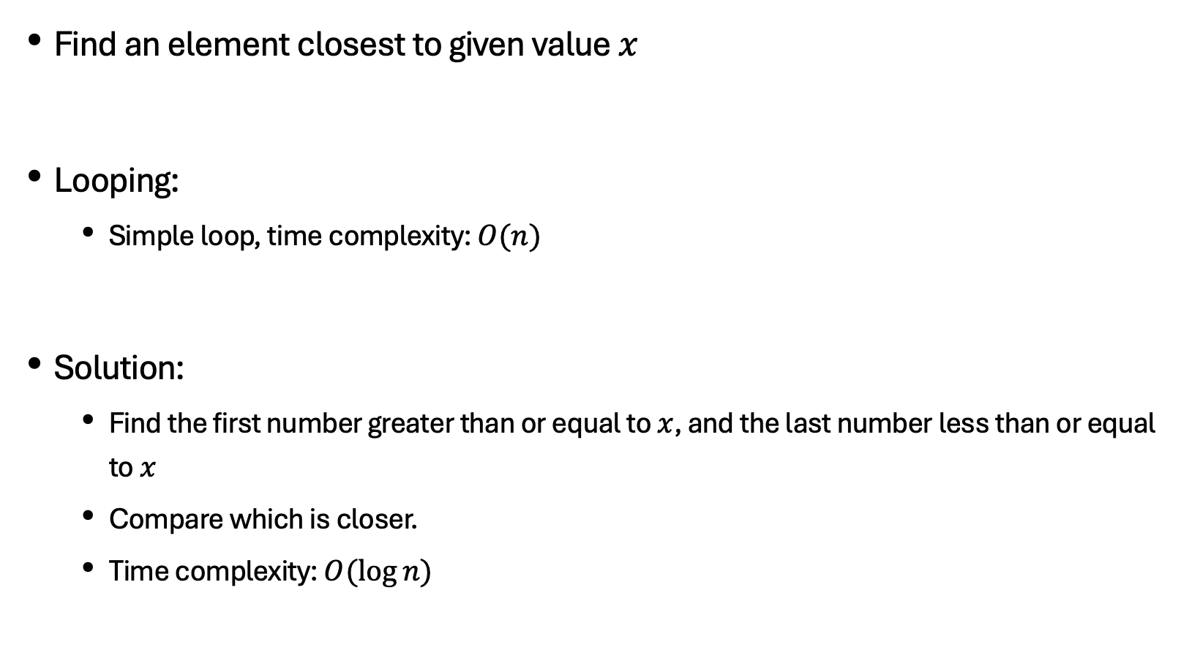
Example problem: Find the closest element
Find an element closest to given value $x$
Looping:
Simple loop, time complexity: $O(n)$
Solution:
Find the first number greater than or equal to $x$, and the last number less than or equal to $x$
Compare which is closer.
Time complexity: $O(\log{n})$
Notes:
XMOJ 1237

Slide 16
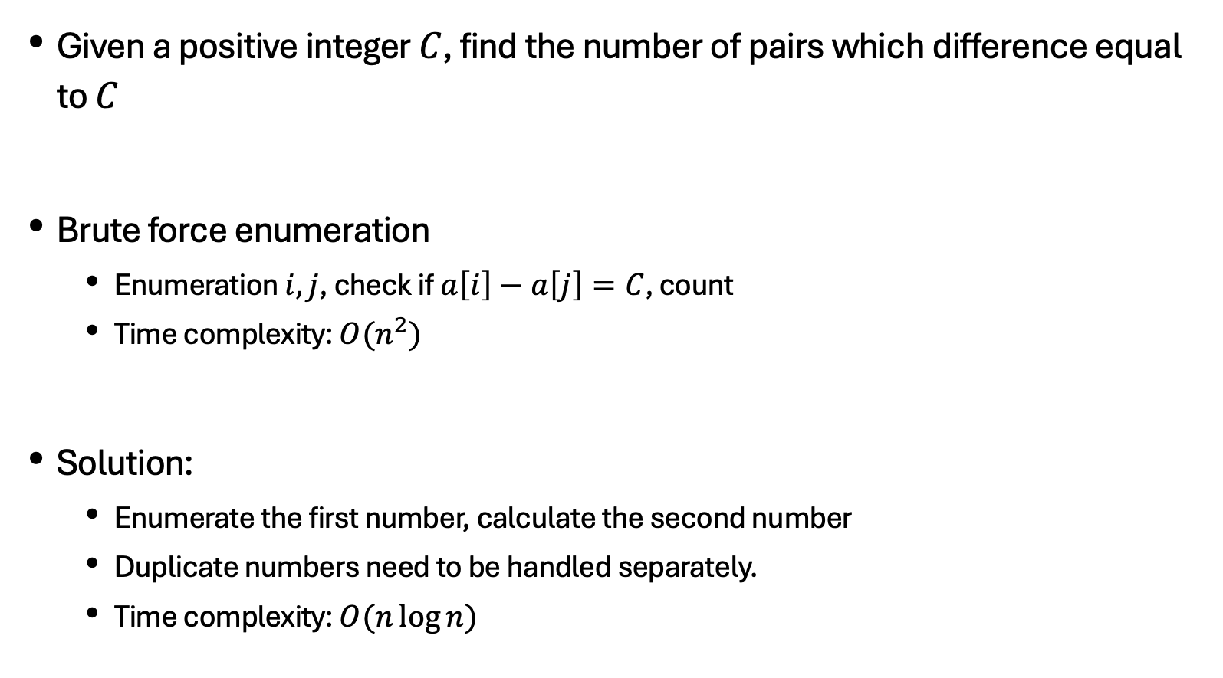
Example problem: A- B (Pro version)
Given a positive integer $C$, find the number of pairs which difference equal to $C$
Brute force enumeration
Enumeration $i,j$, check if $a\left[i\right]−a\left[j\right]=C$, count
Time complexity: $O(n^{2})$
Solution:
Enumerate the first number, calculate the second number
Duplicate numbers need to be handled separately.
Time complexity: $O(n\log{n})$
Notes:
XMOJ 1238

Slide 17
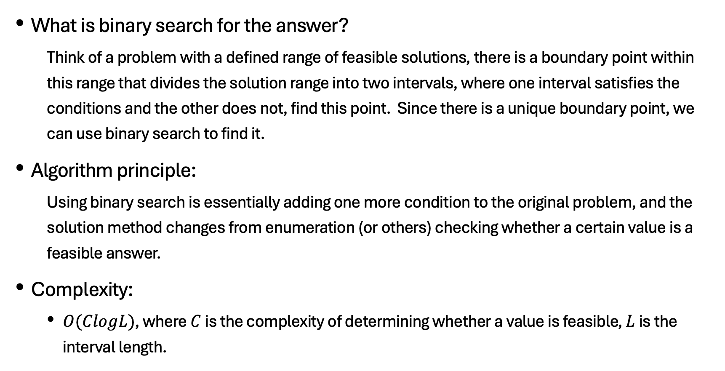
Binary answer
What is binary search for the answer?
Think of a problem with a defined range of feasible solutions, there is a boundary point within this range that divides the solution range into two intervals, where one interval satisfies the conditions and the other does not, find this point. Since there is a unique boundary point, we can use binary search to find it.
Algorithm principle:
Using binary search is essentially adding one more condition to the original problem, and the solution method changes from enumeration (or others) checking whether a certain value is a feasible answer.
Complexity:
$O(ClogL)$, where $C$ is the complexity of determining whether a value is feasible, $L$ is the interval length.

Slide 18
Binary answer

Slide 19
Example problem: Logging
You need to fell at least M meters of timber. What is the maximum height at which trees can be felled?
Notes:
XMOJ 1238

Slide 20
Example problem: Pie
If each person must have one piece pie of the same size, what is the maximum volumn of that piece?
Notes:
XMOJ 1238

Slide 21
Example question: Monthly expenses
Given N numbers divided into M consecutive blocks, find the solution with the smallest maximum block sum.
Notes:
XMOJ 1238

Slide 22
Thank you everyone.
Note: Please turn off your microphone and camera.
Teacher Gao's Algorithm Competition Training Camp

